Slide 1


All4Palestine Social Network
Javna mobile media & technology solutions

Slide 2
Introduction
All4palestine objective - Through the "All 4 Palestine Initiative," Palestine will benefit from the expertise of its sons and daughters in all fields and sectors
How to achieve objective - Build a platform that connect, initiate and engage expertise and people in all fields in dialogues and initiatives that will influence the arrangement and development of social, economic related issues
How to better achieve objective - by leveraging social networks & mobile

Slide 3
Facts and Statistics
Over 50% of the world’s population is under 30-years-old
96% of them have joined a social network
Social Media has overtaken porn as the #1 activity on the Web
Years to Reach 50 millions Users: Radio (38 Years), TV (13 Years), Internet (4 Years), iPod (3 Years)…
Facebook added over 200 million users in less than a year
iPhone applications hit 1 billion in 9 months.
If Facebook were a country it would be the world’s 3rd largest
There are over 200,000,000 Blogs in existence
Over 1.4 billion internet users
Over 4.5 billion active mobile subscribers
Over 5 billion mobile app downloads

Slide 4
Thus….
An All4palestine social network accessed via mobile and internet will introduce better results for the initiative by involving expertise and people intended to influence the arrangement and development of social, economic , related issues
Where….
The aim of An All4palestine social network is to facilitate and introduce results on a socially acceptable combination of wealth creation, economic and social progress, social security, stability and equity

Slide 5
Challenges
Current Social Networks are about sharing and exchanging information
Exchange of information on the current Social Networks implies no real discussion or action on the issues concerned
Sharing information across networks is one way. Not dialogue base
No across social networks dialogues
No dialogues across communications networks (Email, mobile ,IM) from social networks
No group based dialogues across social & communications networks
No dialogues with none social networks users
There is a need to provide a Network that facilitates a constructive interactive communications between users from across social and communication networks. That is the All4palestine Social Network.

Slide 6
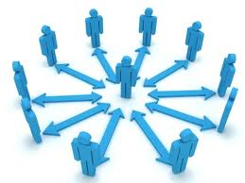






Proposed Solution
A social network-based technology platform accessed via mobile and internet that facilitates a constructive interactive communications between users from across social and communication networks in order to arrive at social consensus compromise among the stakeholders in a society.
Provides an effective tool for solving collective challenges by creating a Network with a structure and environment suitable for more efficient problem-solving.

Slide 7
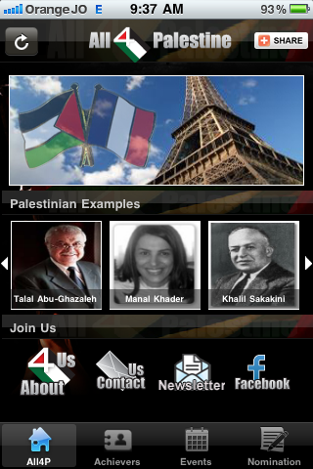
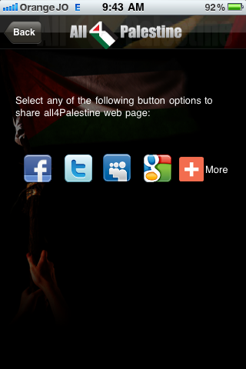
Proposed Solution - Mobile

Slide 8















Proposed Solution - WEB
Public
Post a Dialog
Private
Khaled G
Khaled G why is ALWAYS your fault when u fail, when u r not motivated,when u panic,when u get angry, when u yell, when you r bored, when feeling down
45 minutes ago
Mansour Mansour Because you should be responsible for your actions
22 minutes ago
Khaled G why is ALWAYS your fault when u fail, when u r not motivated,when u panic,when u get angry, when u yell, when you r bored, when feeling down
45 minutes ago
Mansour Mansour Are you OK Khaled
19 minutes ago
Khaled G ads and app sale won't cover operations and development cost. Also no clear forecast or plan for breakeven
2 hours ago
Carl G Blame it on Rio
15 minutes ago
Khaled Everybody says good morning on social networks simply to look cool.. Oh lalala
3 hours ago
ZIadAly Which one you are now fail, not motivated, panic, angry, yell, bored or down
11 minutes ago
Pete Cashmore May be All ☺
10 minutes ago
Khaled G Aljazeera showing a documentary about old city of #Yafa interviewing Tawfiq Gharghour #Palestine
4 hours ago
Cali Lewis Are you making a statement about your current mood or this is up for discussion
09 minutes ago
mmansour@javna.con I guess Khaled not in a GOOD mood
05 minutes ago
+96279xxxxxxx Khaled how about if we discuss this over coffee
02 minutes ago

Slide 9

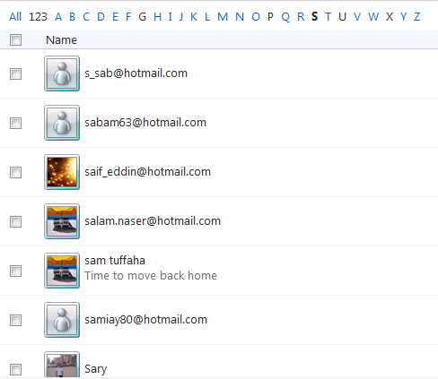



Proposed Solution - WEB
Public
Post a Dialog
Private
Khaled G
why is ALWAYS your fault when u fail, when u r not motivated,when u panic,when u get angry, when u yell, when you r bored, when feeling down
Khaled G ads and app sale won't cover operations and development cost. Also no clear forecast or plan for breakeven
2 hours ago
Khaled Everybody says good morning on social networks simply to look cool.. Oh lalala
3 hours ago
Khaled G Aljazeera showing a documentary about old city of #Yafa interviewing Tawfiq Gharghour #Palestine
4 hours ago

Slide 10
Next Steps
Secure Investment for technology development and launch
We are seeking ~$1.2 million capital with a monthly burn rate of ~$100k. The fund will be used to 1) Complete the development of the first release by growing technical team 2) start a pilot with a close circuit that will involve certain number of people some are active on social networks and some are not (regular people, NGOs, journalists, syndicators, industry/market/society figures, and some government officials ) where the outcome of this pilot should show how we can achieve more out of social networks

Slide 11
Thank You
Q&A

